Slide 1
WEATHER DATA ANALYTICS USING BIG DATA ANALYTICS
Department of CSE Final Project Review A.Y. 2025-2026
TEAM 16 MEMBERS
• P. Hrishikesh Reddy
• P. Abhinav
• M. Sohan Reddy

Slide 2
Introduction & Motivation
Data Explosion: Massive datasets from satellites and sensors.
The Bottleneck: Traditional SQL/Excel tools lack scalability.
Big Data Solution: Distributed processing and real-time analysis.
Motivation: Fast and accurate weather analysis for global planning.

Slide 3
Proposed Methodology
1. Data Collection: Large-scale historical weather datasets.
2. Preprocessing: Cleaning and normalization via Pandas/Tidyr.
3. Storage: Efficient Big Data compatible structures.
4. Analysis: Statistical modeling & trend identification.
5. Visualization: Interactive dashboards and insights.

Slide 4
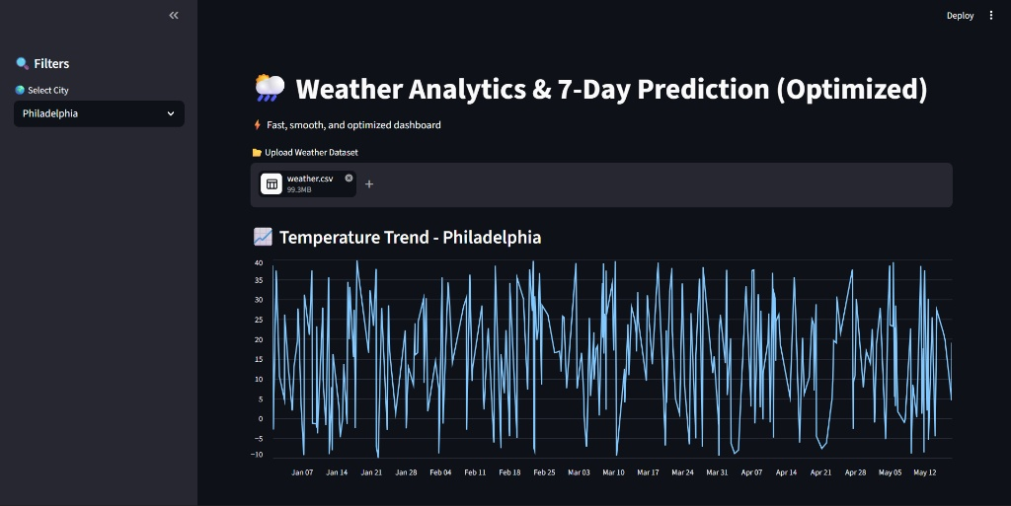
Project Result: Historical Trend Interface

Slide 5
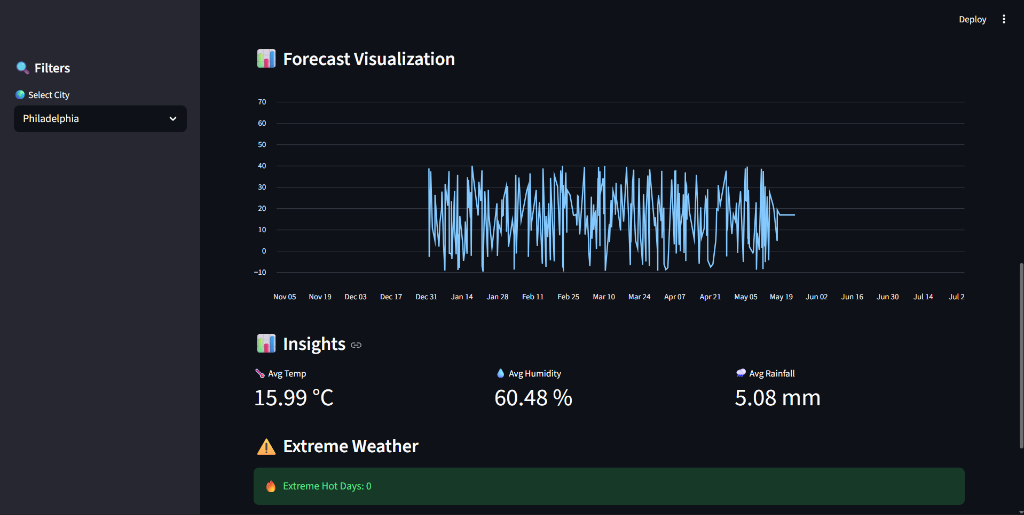
Project Result: 7-Day Prediction Dashboard

Slide 6
Implementation: Core Python Logic
@st.cache_data def load_data(file): return pd.read_csv(file) @st.cache_resource def train_model(X, y): model = LinearRegression().fit(X, y) return model # 7-Day Forecast Calculation future_days = np.arange(len(city_df), len(city_df) + 7).reshape(-1, 1) predictions = model.predict(future_days)

Slide 7
Performance & Key Outcomes
• Scalability: Optimized pipeline handling massive daily datasets.
• Speed: Used @st.cache for near-instant rendering of results.
• Insights: Automated 'Extreme Weather' day detection logic.
• Reliability: Cleaned and preprocessed codebase for robust analysis.

Slide 8
Conclusion & Future Scope
• Proven feasibility of Python/Streamlit for big data weather tools.
• Future: Moving to Apache Spark for multi-terabyte scale.
• Future: Integration of real-time IoT sensor API feeds.
• Future: Implementing Deep Learning (LSTM) for non-linear trends.

